Slide 1



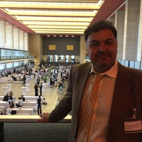
The Late Antique in Iran: the interpretation of Khodad Rezakhani
Presentation of Gianluca Borreca

Slide 2

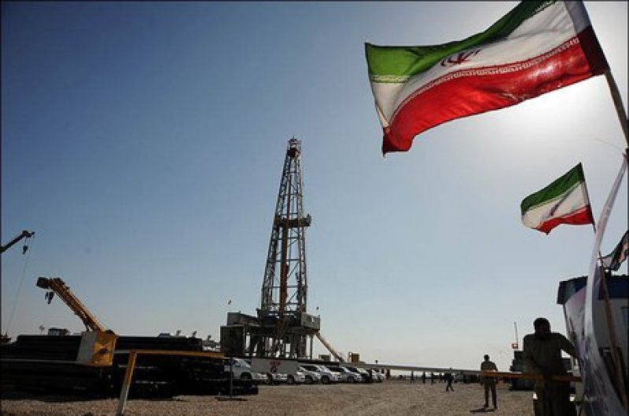
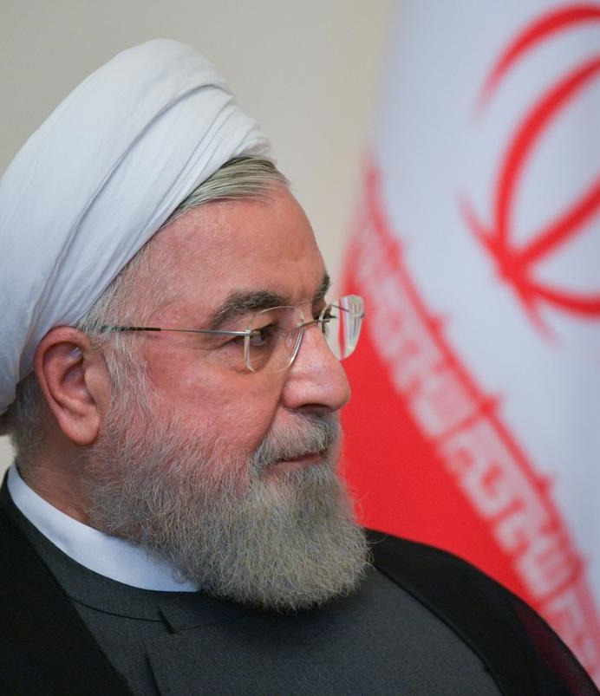
10/11/2019
The Iranian President Hassan Rouhani announced that a new large oil field with a capacity of about 53 billion barrels of crude was discovered in the Iranian province of Khuzestan.

Slide 3

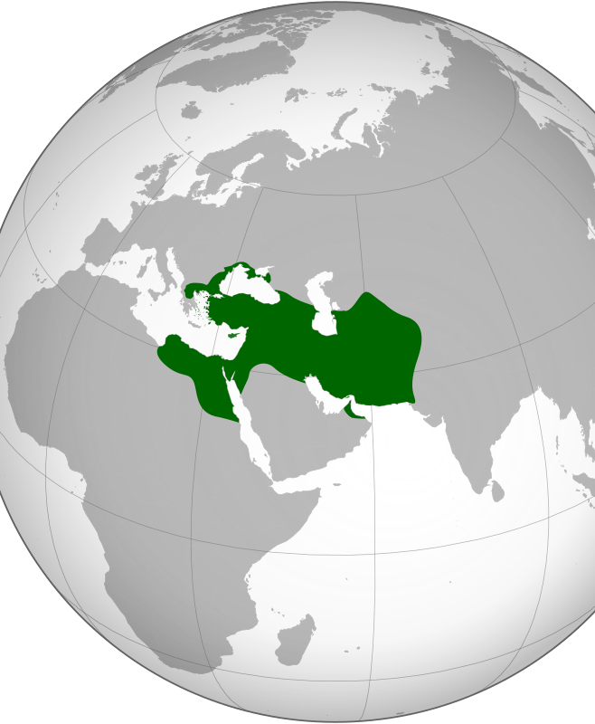
How was the "geo-political" influence of Iran in the Ancient Period?
Battle of Marathon 490 BC: Victory of the Greeks
Battle of Thermopylae 480 BC: Legend of the 300 Spartans

Slide 4

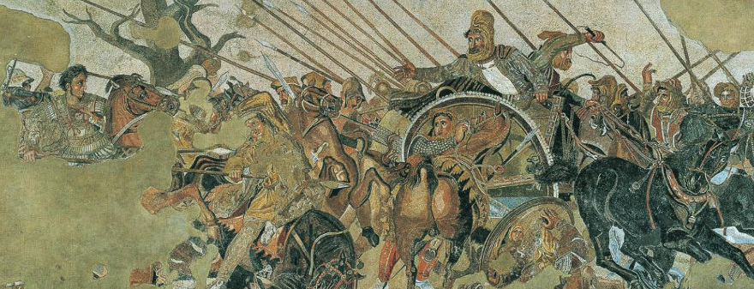
Battle of Issus 333 BC
Victory of Alexander the Great
National Archaeological Museum of Naples

Slide 5
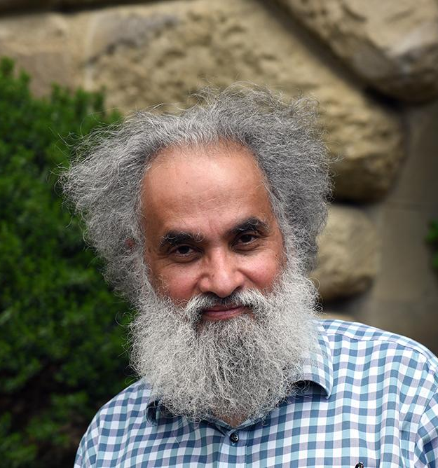

Sanjay Subrahmanyam
(born May 21, 1961) is an Indian historian specializing in the early modern period
<< The world of the early Modern Age appeared for the most part as a patchwork of intertwined empires, competing with each other, punctuated by a strange intruder, the "nation-state" in gestation>>
Could we apply the vision of Globalized History regarding the Late Antique period in Iran?

Slide 6

The Arab Conquests and Sasanian Iran Khodadad Rezakhani
<< Apart from Late Antiquity, another framework that needs to be considered – and I have been most insistent on its adoption – is that of world history. The gist of this approach is to ponder a greater, trans-regional context for both the Sasanian Empire and the rise of Islam. This is not to simply consider the broader history of the Mediterranean and West Asia, but to take contemporary political, cultural, and economic forces into account in a serious way. […]
Compound histories (e.g. political, economic, cultural, social, or gender history) have to become a reality in the study of periods of history far beyond the pre-modern one, their dominant playground. World history, as a methodology that can act as a cover for all these interdisciplinary approaches to history, needs to be applied so we can properly understand the period under discussion here.
Late Sasanian Iran, essentially the period after 484 CE, is a prime example of how we might put these methodologies to use. >>
Link source: file:///C:/Users/Io/Downloads/The_Arab_Conquests_and_Sasanian_Iran_Kho.pdf

Slide 7
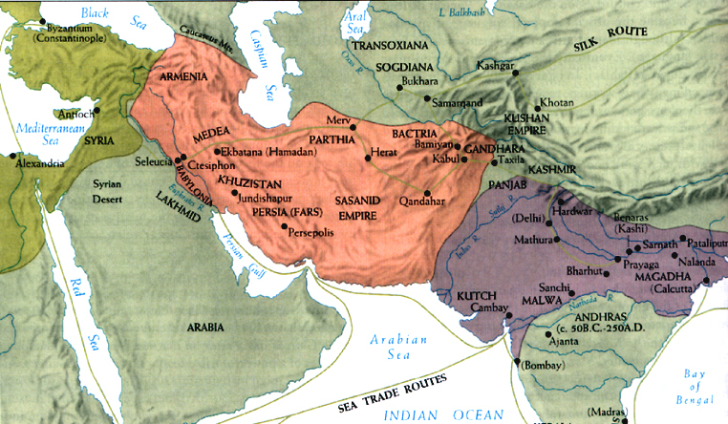
“Economic” Conflict between the Persian Empire and the Sassanid Empire
Constitution of Theodosius II
<< It is necessary that the merchants, so subject to our Empire as to the king of the Persians, do not at all carry markets outside those localities, on which we agreed at the time of the pact with the aforesaid nation so that the mysteries of a foreign kingdom are not spied on , which is not appropriate. Therefore, as a result of this, no one subjected to our Empire would dare go to buy or sell goods elsewhere than Callinicus, Nisibis and Artaxata [the first in Roman territory, the second governed by the Persians, the third in Armenia] and believes it should exchange goods (merchandise) with a Persian elsewhere than in the aforementioned cities: both parties are aware that the goods that have been sold or bought outside those places must be claimed by our sacred treasury, and that, in addition to the duration of those and the money, that he has been paid or exchanged, he will be subjected to the eternal penalty of exile >> (Codex Justinian IV, 63, 4)
Page 191-192 Economics and finance in Rome by Filippo Carla, Arnalodo Marcone

Slide 8


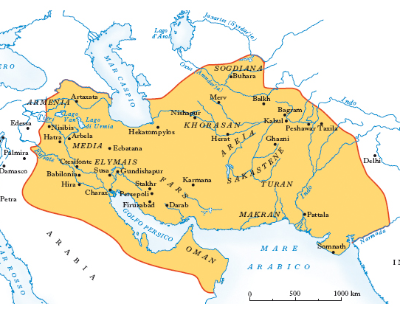
“Economic” Conflict between the Persian Empire and the Sassanid Empire
The peace treaty between Justinian and the Sassanids of 562 included:
<< The Roman and Persian merchants of all kinds of goods, these and analogous merchants, trade according to the custom established by ancient time in the specified places of tax collection >> (Menander the Guardian)
Menander explains the purpose of these measures. The objectives were:
1) control the traffic of prohibited products
2) avoid espionage activities
3) submit the sales to the required taxation
The Roman Empire took these types of initiatives precisely on the borders where the populations were found to which the right to trade freely in the territory of Roman Empire was not granted. These were moments of particular conflict.
This is demonstrated by some provisions of Marcus Aurelius. In 175 AD Marcus Aurelius concluded the peace with the Marcomanni:
<< established the places and the days of the trade, in fact before they were not fixed >> (Dione Cassio LXXII, 15)

Slide 9
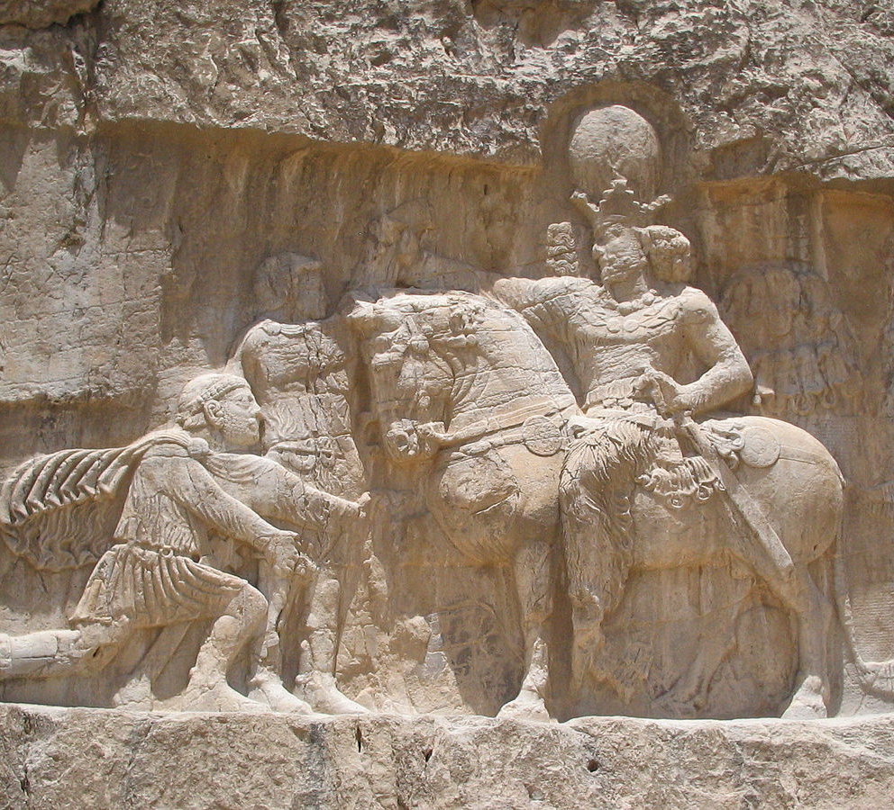
Sapor I vs Roman Empire
"The Caesar Gordian was killed and the Roman armies were destroyed. The Romans then made Caesar a certain Philip. Then the Caesar Philip came to us to treat the terms of peace, and to redeem the lives of the prisoners, giving us 500,000 denarii, and thus became our tributary. [...] »(Res Gestae Divi Saporis, lines 8-9.)
Sassanid relief at Naqsh-e Rustam depicting Sapor I holding companies in Valerian prisoner and receiving the tribute of Philip the Arab, kneeling before the Sassanid sovereign.
«(24) Una grande battaglia fu combattuta tra Carrhae e Edessa tra noi [Sasanidi] e il Cesare Valeriano, e noi lo catturammo facendolo prigioniero con le nostre mani, (25) così come altri generali dell'armata romana, insieme al prefetto del Pretorio,[86] alcuni senatori e ufficiali. Tutti questi noi facemmo prigionieri e deportammo (26) in Persia.»

Slide 10
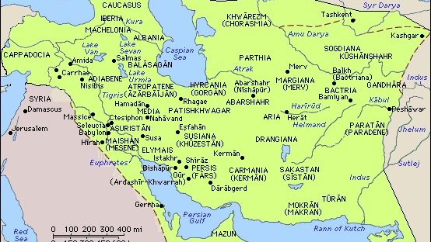
Sassanid Persia under Shapur (maximum expansion)

Slide 11
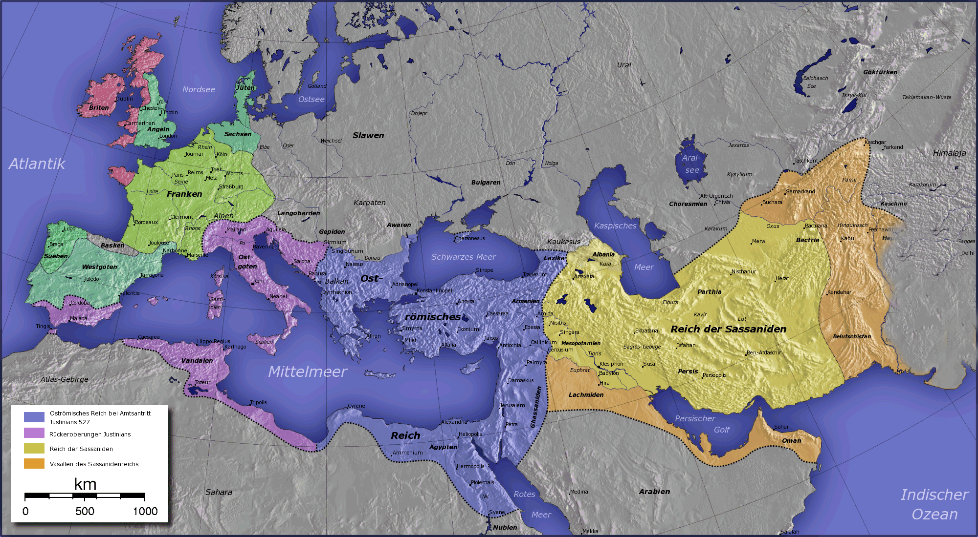

Slide 12
How was the Empire of the Sassanids structured?
Imperial ideology: the imposition of the old Iranian worldview contained in the sacred Zoroastrian text, the Avesta. The ideology was the driving force for the Sassanians and the rasion d'être for what was called Eranshahr or "Empire of the Iranians". Eran, was an invention of the Sasanians who did not exist in the previous Arsacid or Achaemenid empires. This ideology was based on Hellenistic, Mesopotamian and Iranian world views, combined with the local tradition of the Persian lords in the province of Fars.
The Sasan Empire, the empire of self-designated Iranians (Eranshahr), was centered on Ctesiphon in Mesopotamia. In a sense, the "Heart of Eranshahr", as the medieval Muslim geographers called it, was Mesopotamia.
There is a concept of the divine king and Kosmocrat.
Xwarrah, "Gloria" (Lubotsky, 1998), is central to ancient Iranian royal ideology, as demonstrated in the Avesta, and is a prerequisite of the legitimate domain of the Avesta. To obtain this rule, each of the legitimate Kayanid rulers and those who preceded them and the power seekers make sacrifices to the deities to obtain xwarrah. In Iranian art the xwarrah or glory was usually shown by a halo around the king's head, which also appeared in the Sasanian art.
The sacredness of the king of kings and its importance for the welfare of the empire were fundamental to the imperial ideology.

Slide 13

What are the most important aspects of the Sassanid Empire?
Economy
The Sasanid economy depended heavily on agriculture. The Sasanian kingdom suffered from a lack of water, except in Mesopotamia. While Mesopotamia sasana (Surestan) enjoyed an ancient agricultural tradition and relatively reliable water sources, the Iranian plateau consisted of hilly terrain and suffered from an acute lack of rain.
Surestan and Khuzestan owned fertile lands and semi-reliable water. Traditionally, these areas had been used for grain production, as well as for limited horticulture. Recent research shows that the Sasanian state has invested heavily in these areas, creating hydraulic systems for irrigation, probably with the aim of using marginal land. It has also been suggested that with the introduction of new crops, mainly cotton and sugar cane, these areas have been made commercially important.
In the Damghan plain the irrigation has caused intense settlements around the central plain, before retreating into the mountain valleys and passing from production to horticulture

Slide 14
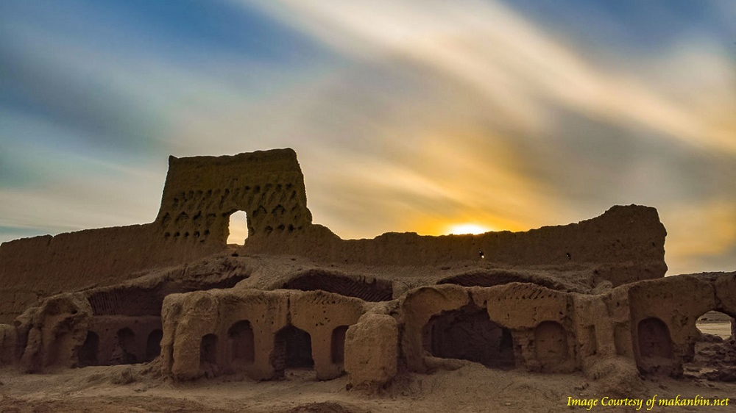
Damghan

Slide 15

What are the most important aspects of the Sassanid Empire?
Business and Trade
In trade, the Sassanians were competing with the Romans on silk and contesting trade to Sri Lanka. There was a Sasana colony in Malaysia that was made up of merchants. Persian merchants tried to get lower prices
Trade with China was conducted through two avenues, namely the famous Silk Road and the Sea Route. Therefore the ports of Persis / Fars became increasingly central. n the Chinese archaeological sites of Kukogng, Yngdak, Suikai, which had links to trade in the Persian Gulf, Persian coins were found. Many of the coins belong to the end of the fifth to the seventh century AD, which again attest to the importance of the Persian Gulf in the late Sasan period.
As for internal trade, we rely on seals. The trade was led by companies and religious communities that combined their resources and formed partnerships. The term used for the joint collaboration in the juridical texts of central Persia is hambayih which actually meant holder of a common share whose joint investment would bring a better return and a wider purchasing power. These joint partnerships were probably also based on a religious association, in which the Zoroastrians created their own hambayih but could have dealt with other religious groups outside their regional reach.
Trade (wazarganih) was conducted in the bazaar (wazar), which today remains the economic center of the small and large cities of Iran.
The activity and prices of the bazaar were controlled by a chief of the bazaar (bed of the wazar), which probably represented the artisan class. It was in these centers that local products were produced, while goods from other provinces and some foreign products entered the cities via caravans. These caravans (karwan) were led by a trailer leader (sartwa), who had been hired by the merchant or in collaboration with him.

Slide 16

What are the most important aspects of the Sassanid Empire?
Religion: Zorastrism
The first Sasanian kings seem to be rather tolerant towards other religions.
The Council of Chalcedon in 451 caused the escape of many "Eastern" Christians towards the Sassanian territories. Therefore it formed of a native and independent Christian community in the Sassanian territories. Eventually, under Khosrow I, Hormizd IV and Khosrow II, this community settled in the Sassanian kingdom and created a central patriarchal seat in Ctesiphon.

Slide 17

Continuity and Change in Late Antique Iran
Rezakhani wonders if there is continuity or discontinuity in the transition from the Late Sasanian Empire (550-651) to Muslim domination (651-750). The most suitable terminology of a "transformation theory". This paradigm allows a better understanding of socio-political developments.
One of the traditional feature is the lack of historical sources.
Why the “transformation theory” in Late Antique? Because we could understand better the past conditions of the “status of La Mecca”, before it conquered Middle East:
The influence between the Sasanian and the Byzantine. They also had one great war and was so damaged about that (Eraclio wars 602-628)
Arabia was influenced by great areas of urbanitation, particularly in Siria

Slide 18

Continuity and Change in Late Antique in Iran
Problems about historical sources:
The historical method to study the transition from the Sasanian Empire to the Arab conquest is a "polyphonic" and multicultural method. A very broad cultural point of view is adopted, so that connections can be made between the Sasanian Empire and its "neighbors" (Barbarians, White Huns, China and Arabia).
Roman historians were connected to the political life of Rome and judged the Persian Empire in hostile terms.
Therefore we try to study Arabic, Islamic, Syrian and archaeological sources (Ka'aba Zardosht, Narse's Paikuli inscrption, Kerdirìs inscription)
Let's make a big difference:
Archeology is closer to a population-based viewpoint.
Religious texts and administrative texts tend to give us a centralized image of political power.

Slide 19
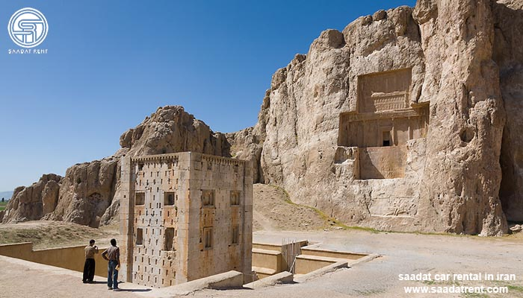

Slide 20
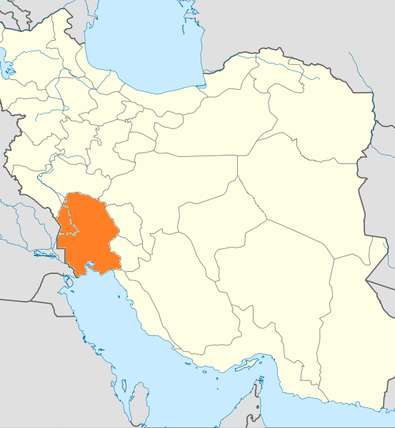
Late Ancient in Khuzestan
Is there a depopulation in the Late Antique period? How is it possible that there are at the same time large investments for the irrigation plants and for the formation of the Gundisapur academy?
The Khuzestan area will never reach the production levels of the Parthian Kingdom due to political instability in the Late Empire of the Sassanids.
The area has been studied by "Stratigraphy". The "Stratigraphy" tries to concentrate on the size of the probed territory and the quantity of ceramic present.
The difficulty of this method is to give "circular" answers. The "Matrix Forming" method (determining a match of date, volume of ceramics and socio-political aspects) is not discussed enough by the Multi-Dimensional.
The area was heavily affected by large investments by the central administration. Thus in Khuzestan the uneven increase in population and an increase in agricultural production did not coincide with the political crisis.

Slide 21
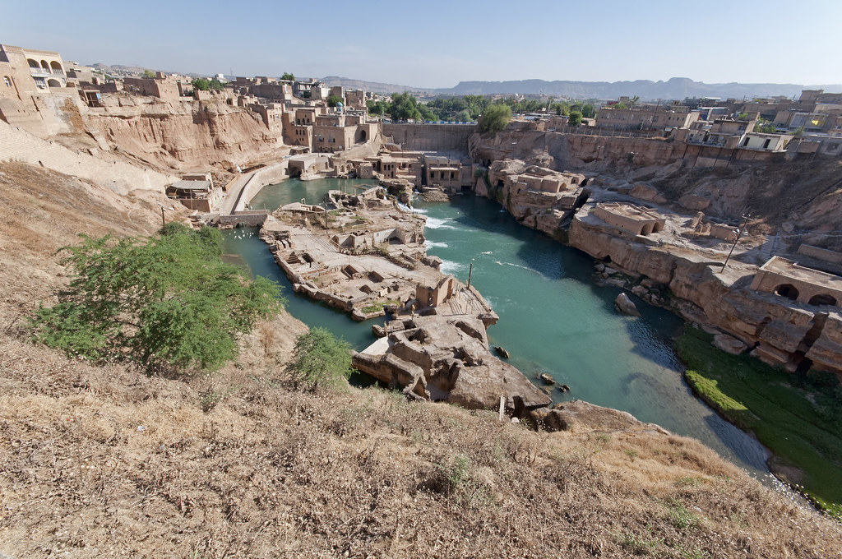
Shustar

Slide 22
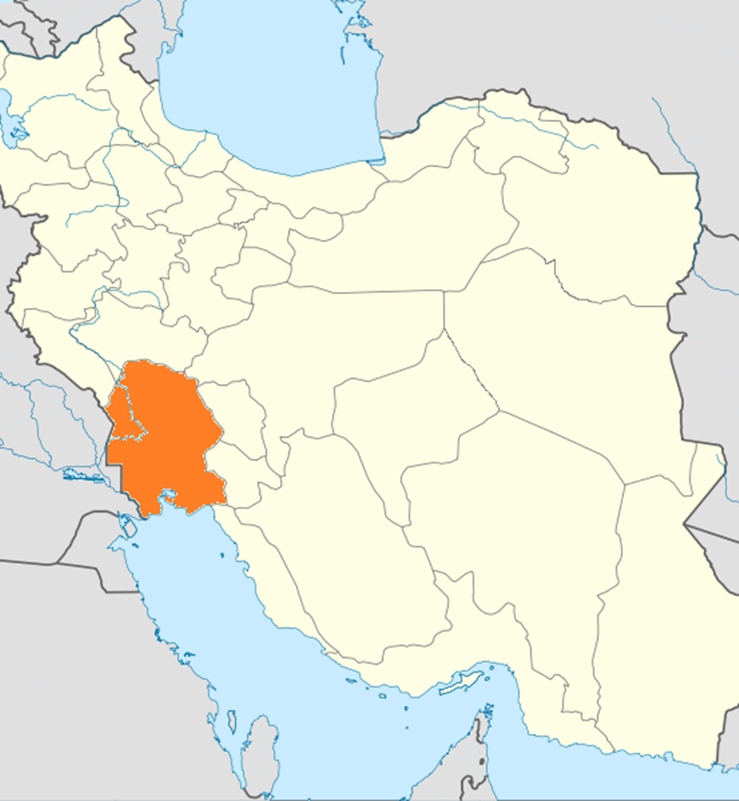
Khurzestan economy
One of the possible fields of historical investigation for the Late Ancient period of the Sasanian Empire is the agricultural economy. The agricultural economy in Khuzestan was very developed. Shustar's amazing irrigation system proves this.
Even in Khuzestan new types of crops were introduced: rice and sugar.
The cultivation of rice allowed to alternate the lands in summer and winter. All this allowed an increase in investments and greater demand for work.
While the cultivation of sugar can be explained only thanks to the presence of highly developed irrigation systems.
Let's not forget the cultivation of pistachio, apricot and chestnut.

Slide 23
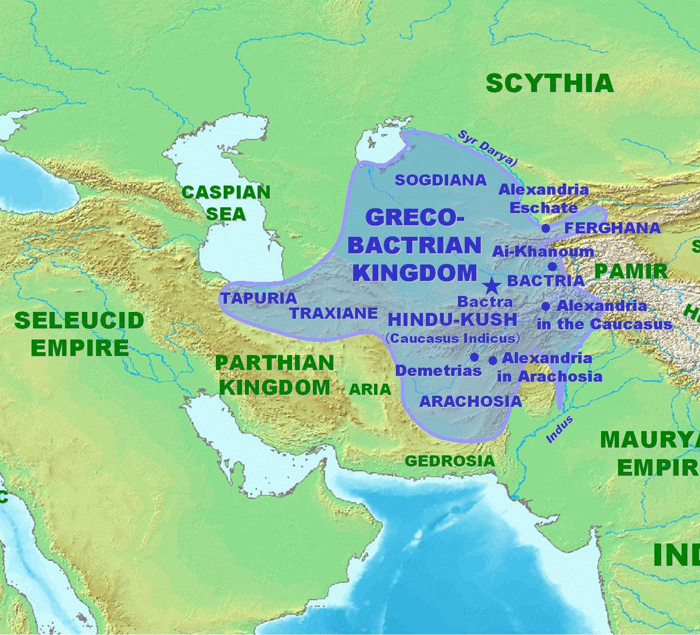
Late Antique Bactria
Late antique Bactria is remembered as "the land of the 1000 cities". In fact Alexander the Great favored a great work of urbanization in the area.
Very important were the contact with "the Empire of the Kushans" (0-375). However, the late ancient Bactria will suffer from a phenomenon of depopulation or abandonment.
All this is due to the migration of the people of the White Huns.
The agricultural economy was connected to the cottone, the wheat and the horses.
However, the region is linked to the economy of transhumance.
The presence of the White Huns in the territories owned in the past by the Sassanids generated "geopolitical confusions". There was even a penetration of a Buddhist community.

Slide 24
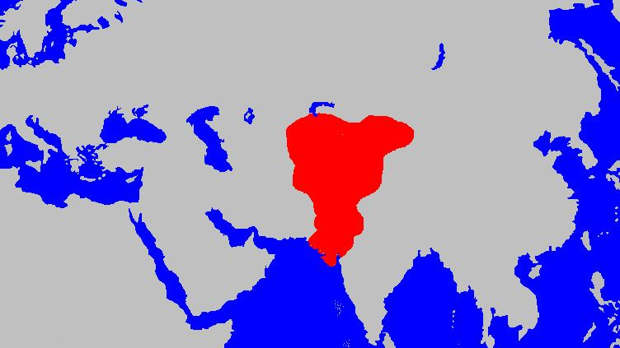
Reign of White Huns 520

Slide 25
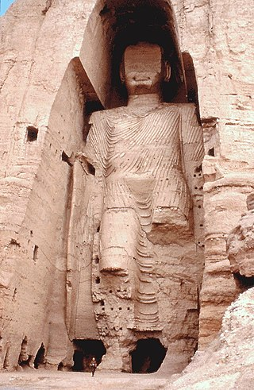
Buddha di Bamyan

Slide 26
Conclusions
Khuzestan | Bactria
Empire Garden Fully integrated into the Sasanian administration system | East area of the Sasanian Empire Here is the migration of the White Huns and a monetary crisis
Investments in hydraulic systems Consistent urbanization, evidenced by archeology There is a disambiguation: Archeology shows a demographic and economic decline Coins, Irration, Water Resources testify to an economy in recovery. Add elements such as new types of crops (rice and sugar), new irrigation methods | Less developed hydraulic systems Economy more on a regional basis Here the official documents want to give an illusory central power The presence of landlordism is verified

Slide 27
Conclusion
<< The Sasanian Empire was one of the major forces of the late antique world. Often represented as the “adversary” of the Roman Empire in the east, and thus on its “periphery,” the Sasanian Empire was in fact the center of a prolific sociocultural, political, and economic sphere that became widespread following its conquest by the Muslims. Political centralization, robust and expanding economy, socioreligious innovations and changes, and growing cultural activities made the Sasanians the blueprint for subsequent polities in the region. Often underresearched, many aspects of Sasanian culture and society are left unknown, and thin connections are made via shallow evidence for such influences. The emerging evidence and the development of more sophisticated studies of the period would no doubt show the centrality of the Sasanians in the late antique world, and assess their lasting legacy in the history of West and Central Asia up to modern times. >>

